Slide 1
Introduction To Unreal Engine 5
DX1217 3D Game Level Design
Background Concepts and Formatting Updates

Slide 2
Unreal Engine 5 Documentation
Epic Games Launcher
Unreal Project Structure
Content Pipeline
Editor UI Overview
Actors
Tools & Features
Table of contents

Slide 3

UE5 Documentation
Unreal Engine v 5.2
Image courtesy of Game Science

Slide 4
Unreal Engine 5 Documentation
https://docs.unrealengine.com/5.0/en-US/
Notes:
To get help with many of the new features UE5 provides, check out the online documentation.
Here you can find information about all of the new features UE5 supports and how to use them.
This will update over time to make sure to check it out.

Slide 5

Epic Games Launcher
Unreal Engine v5.2
Image courtesy of Game Science

Slide 6
Epic Games Launcher
Notes:
The EpicGames Launcher: Light-weight app, one-stop-shop for all UE5 needs
Use it to start the engine. You can have more than one major version of UE5 installed simultaneously
Use the Library to get easy access to existing Projects as well as streamlined ways to upgrade your Engine builds and associated plugins
Get easy access to downloadable content, samples, learning materials and community news

Slide 7
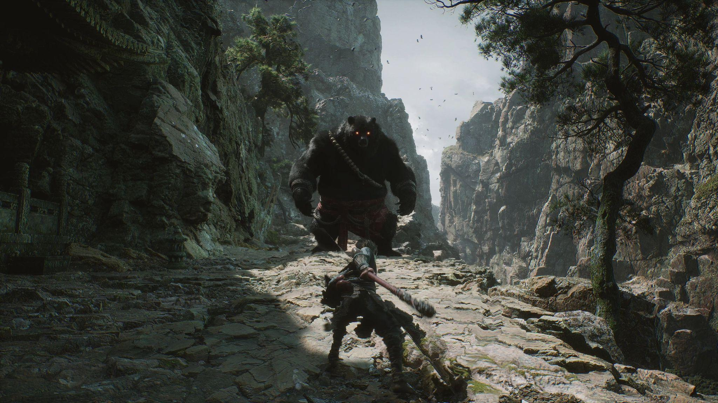
Unreal Project Sructure
Unreal Engine v5.2
Image courtesy of Game Science

Slide 8
Unreal Project Structure
Traditional Apps
Traditional apps use a single project file to visualize a scene
PHOTOSHOP
SAVE
.PSD
SOFTWARE
SAVE
FILE
WORD
.DOC
SAVE
MAYA
SAVE
.MB
Notes:
Project Browser: Organize your new & existing projects
Existing projects appear in the Projects tab
The New Project tab uses a wizard to create a new project based on a template
Film
Architecture
Automotive
Games
Can create blueprint templates for projects
Templates work as starting points, and they have been designed to cater for a variety of situations.

Slide 9
Unreal Project Structure
UE5 File System
All imported assets (models, textures, audio, animations…) are stored in the Content folder as .uasset files
Levels are saved as .umap
Projects are saved as .uproject
Level Editor
SAVE
My_Level.umap
UE5
Asset Editor
SAVE
My_Model.uasset
Material Editor
SAVE
My_Material.uasset
PROJECT
MAYA
SAVE
My_Mesh.fbx
IMPORT
My_Mesh.uasset
AGGREGATE
Photoshop
SAVE
My_Texture.png
IMPORT
My_Texture.uasset
Notes:
.uasset Files: assets in Unreal.
All imported assets (models, textures, audio, animations…) are stored in the Content folder as .uasset files.
A .uasset file is a Content Package that contains the imported source as well as other asset-specific information.
.uasset files are converted on the fly to the correct format the project is deployed and running on.
.uasset files can only be read and displayed in the Content Browser.

Slide 10
Unreal Project Structure

Slide 11
Unreal Project Structure
Notes:
Project Folder Structure: how a UE5 project is saved to disk
Traditional apps use a single project file to visualize a scene
A project in UE5 is a collection of source code files, content asset files, plug-ins, configuration files stored in a folder and sub-folders.
At the root of that folder is a .uproject file. It’s actually a text file that associates the project with a UE5 version and plugin installations
The Config sub-folder holds the settings of your project in .ini format files.
The Content folder stores all the assets needed by your project. Assets are typically in .uasset and .umap formats
The Intermediate and Saved folders are temporary and/or generated on the fly and store backup files and files required to compile and run the level.
When saving the project with the intent of opening it on a different system, use “File > Zip Project” to create an archive that contains only the .uproject file, Content and Config folders.
When planning to use assets in other projects, use Asset Actions > Migrate to pull all the necessary asset references

Slide 12
Unreal Project Structure
Project
Levels
Sub - Levels
Actors
Notes:
Project Structure: how things are organized.
An Unreal Engine project is not made of a single file but rather a collection of source-code files, content asset files (as you create and/or import them), plugins, configuration files and other support files.
A Level is a container for every object you see and interact with. It is made of a collection of assets that work together to bring your vision to life. It can range from massive worlds to small rooms with only a few actors.
A Sub-Level is technically a level in its own right, but mostly used for the purposes of level-streaming, where you can load and unload parts of your world to increase performance. The nature of a sub-level is such that it is often used in collaborative environments. A sub-level can then be referenced by a given level in your project for a variety of reasons including level-streaming.
Actors are objects that can be placed in the world and be transformed through the use of Move, Rotate and Scale. They can be rendered and can have materials applied, collision properties and scripted logic; and they can also be animated. There are different classes of actors such as the StaticMeshActor which is most common, but also for lights, sounds, particle systems and cameras.

Slide 13
Unreal Project Structure
.UMAP & .UASSET Workflow
Internal Flies
Saved To
Saved To
External Files
Lights
.UASSET
.UMAP
Volumes
.UASSET
Landscape
.UASSET
Build Data
.UASSET
Bottleneck
Notes:
One File Per Actor
In previous versions of Unreal Engine, when you wanted to make changes to one or more Actors inside a Level, you needed to check the .UMAP file from source control.
This locked other team members out of that file until your work was complete, slowing down the development process since only one person could work on a file at a time.
While you can have more .UMAP files and use them like layers, the possibility of someone being locked out of a file because someone else is using it, is high.
Internal – This refers to assets created from within the UE5 editor.
External – This refers to assets created externally and then imported into UE5.

Slide 14
Unreal Project Structure
One File Per Actor
Internal Files
Link To
External Flies
Lights
.UASSET
.UASSET
.UMAP
Volumes
.UASSET
.UASSET
Landscape
.UASSET
.UASSET
Build Data
.UASSET
.UASSET
Notes:
One File Per Actor
One File Per Actor (OFPA) reduces overlap between users by saving data for instances of Actors in external files, removing the need to save the main Level file when making changes to its Actors.
The One File Per Actor feature is only available in the Editor.
Using this will create a lot of perforce check-ins.
It is recommended that you use UE5 source control interface to handle the checking in and out of files when using One File Per Actor.
All Actors are embedded in their respective Level files when project is cooked.
OFPA is meant to work in tandem with world partition and using it outside of this is considered experimental.
Internal – This refers to assets created from within the UE5 editor.
External – This refers to assets created externally and then imported into UE5.

Slide 15
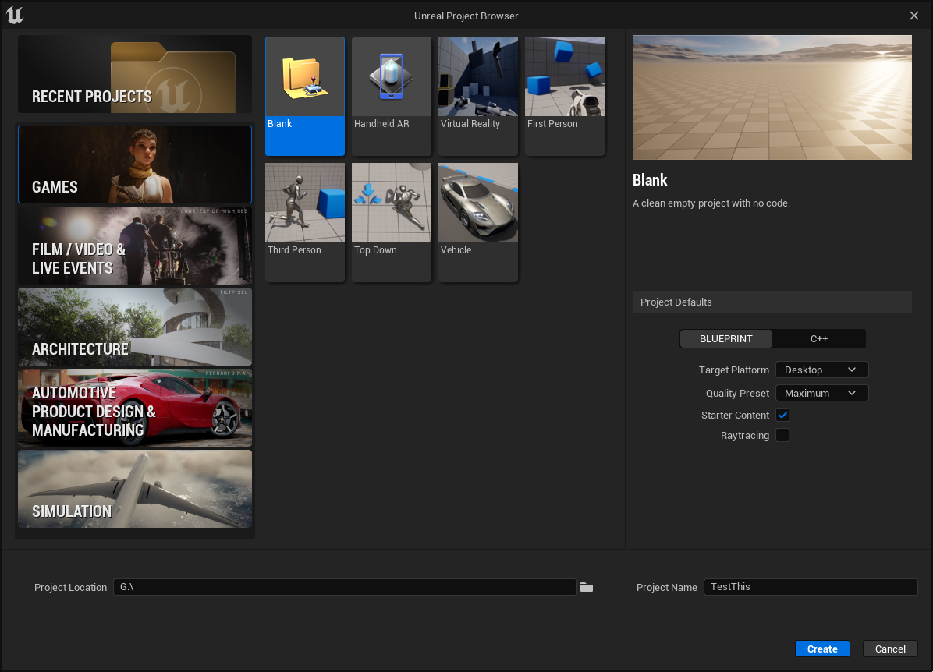
Unreal Project Structure
Notes:
Project Browser: Organize your new & existing projects
Existing projects appear in the Projects tab
The New Project tab uses a wizard to create a new project based on a template
Templates work as starting points, and they have been designed to cater for a variety of situations

Slide 16

Content Pipeline
Unreal Engine v5.2
Image courtesy of Game Science

Slide 17
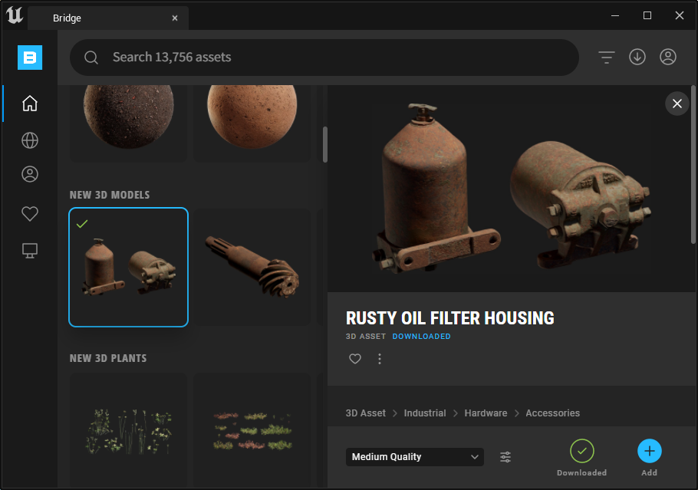
Content Pipeline
Drag & Drop from OS Folder or Desktop
Notes:
You can import assets a few ways.
Content Browser
Using the Add button you can do the following:
Import from drive
Add feature or content pack
Add Quixel Content
Dragging and Dropping from your OS into the Content Browser.
You can add the following file types this way
Static & Skeletal Meshes
Any supported texture format
Sounds
You can use Bridge to download and add content
You do this by logging in first
Then press the download button to download the content
Press the add button to add to your project.

Slide 18
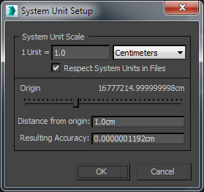
Content Pipeline
UE5 use Centimeters for unit of measurement.
1 Unreal Unit = 1 Centimeter
Make sure to set DCC system / scene scale to CM.
This way you avoid all scaling issues.
Notes:
No matter what DCC you use, you need to make sure your System Units are setup before you start creating items.
I will be using 3Ds Max but this applies to whatever DCC you are using.
UE4 use Centimeters for it’s default unit of measurement.
Having the right scale is key to a good user experience.
The wrong scale or mismatched scales can break any and all emersion you have built, especially in VR.

Slide 19
Content Pipeline
Textures should always be a power of 2
2, 4, 8, 16, 32, 64, 128, 256, 512, 1024, 2048, 4096 & 8192
Textures do not have to be square.
Supported formats:
Uncompressed: BMP, TGA, PSD
Compressed: PNG, JPG, DDS, HDR
Notes:
Textures that are up to 8k can be imported.
However you should use caution when using 8k maps as they take up a lot of memory.
UE5 supports a number of different texture formats when importing content.

Slide 20
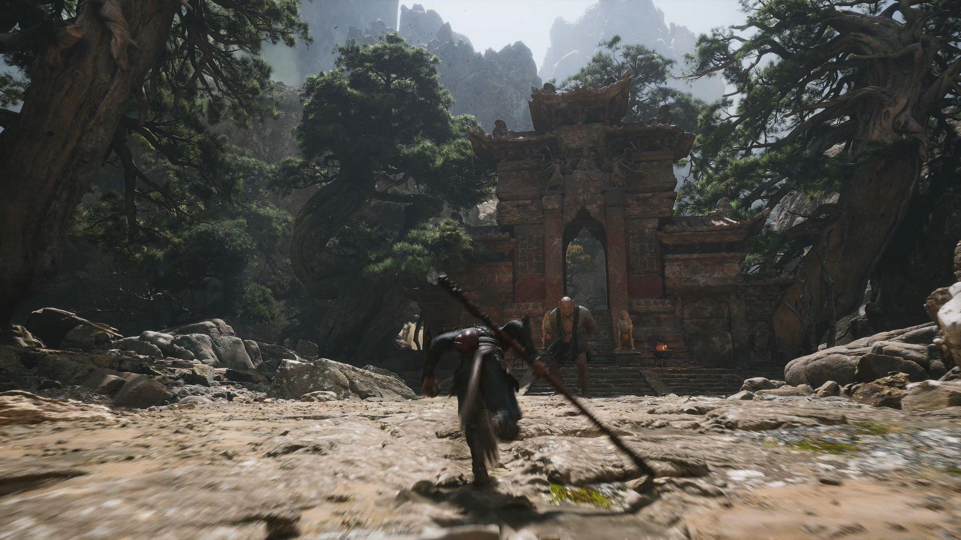
Editor UI Overview
Unreal Engine v5.2
Image courtesy of Game Science

Slide 21
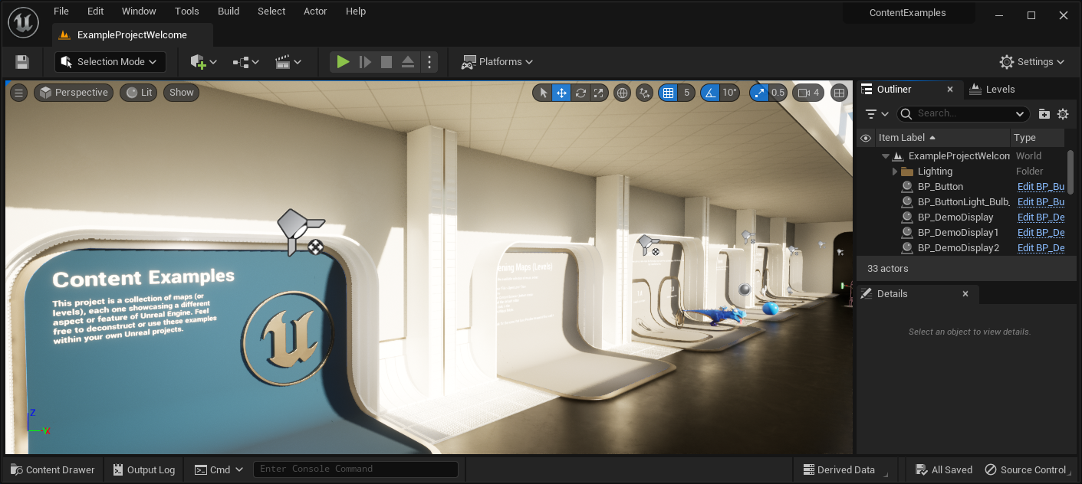
Editor UI Overview
1
2
4
3
5
6
Notes:
The UE5 editor updates bring a suite of improvements to the look and feel of the user interface, creating a modern, improved workflow for all users.
The UE5 editor UI focuses on being smaller and more compact allowing for better clarity and organization.
You might find that many of the UI options that where available in UE4 are available in UE5, just in a different locations.
The following is a break down of what each section in the UI dose.
1: File Menu – Options include but are not limited to:
Making/Opening/Saving level data.
Editing the current project settings for both editor and game.
Displaying different tools and editors.
Helping with the final building of a project’s data.
Documentation and API Reference.
2: Main Toolbar - Options include but are not limited to:
Creating or adding new types of content or actors to levels.
Accessing Content browser or 3rd party content providers
Accessing level Blueprint or any blueprint used in the project.
Managing the level’s or projects cinematics.
There are even options to active different editing modes such as:
Landscape Terrain creation and editing.
Foliage creation and editing
Mesh painting
Mesh Fracture
You will also find the play in editor or PIE options here as well as settings for the level and how some interactions take place.
Make sure to click on the ellipse and double arrows to expose more options.
3: Level Viewport – Options include but are not limited to:
Interacting with and adding items to the level.
Viewing different debug modes to help find issues.
Adjusting grid size and rotation snap settings.
Changing the type of viewport that is used to view the world.
4: Tab Drawer System – Options include but are not limited to:
The Tab Draw systems allows users dock tabs of minimized panels into a drawer on the left or right side of the Level Editor to maximize the viewport.
The most common tab you would find here would be the details panel.
5: Content Browser – Options include but are not limited to:
To maximize screen space the content browser is hidden and you can bring it up by pressing the button or hitting CTRL + Space
6: Console Input– Options include but are not limited to:
This is where you can input various debug and special commands.

Slide 22
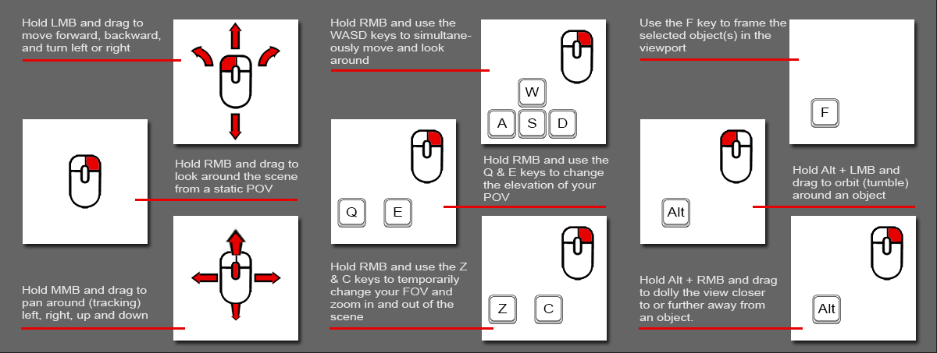
Editor UI Overview
Notes:
There are a number of ways to move around the viewport in UE5
You can use the WSAD keys along with the left mouse button to move.
You can also use only the mouse to move around as well.
Here are some camera movement tips.
WSAD keys to move around
QE keys to go up & down
CZ keys to control FOV
Maya-style controls
F to frame
Alt+LMB to tumble/orbit
Alt+RMB to Dolly

Slide 23
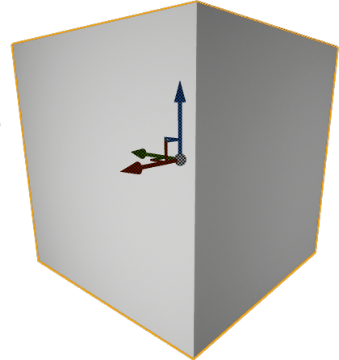
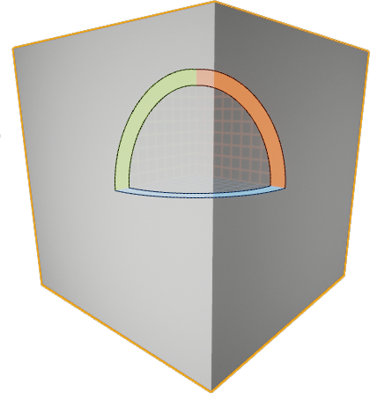
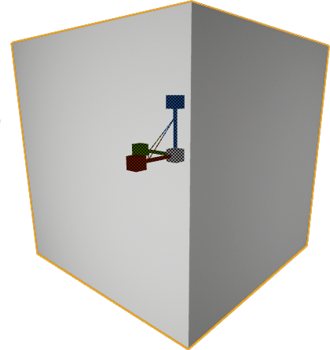
Editor UI Overview
Select, Transform, Rotate, Scale
Surface Snapping
Rotation Grid
World Or Local Space
Movement Grid
Scaling Grid
Move
Rotate
Scale
Notes:
Transforming Objects: Use the Transform gizmo on a selected object or use the Transform type-ins in the Details panel.
Shortcuts:
Spacebar cycles through them all
W for move/Translate
E for Rotate
R for Scale
Hot tip for all transforms:
Ctrl+LMB to constrain to X
Ctrl+RMB to constrain to Y
Ctrl+LMB+RMB to constrain to Z
Use the End key to relocate a selected object so that the lowest point on the object meets the floor

Slide 24
Editor UI Overview
At any point in development, you can use the Play-In-Editor [PIE] button to test your application.
Alternatively, you can use the keyboard shortcut: Alt + P.
Notes:
PIE makes it very easy to see what your project will look like or play like
There are many ways to activate it.
Right-click menu
ALT-P To Play – Use this when you want to run around your world with a character
ALT-S to Simulate – Use this when you want to run things like physics sim and save results
Pressing the Play Button.

Slide 25
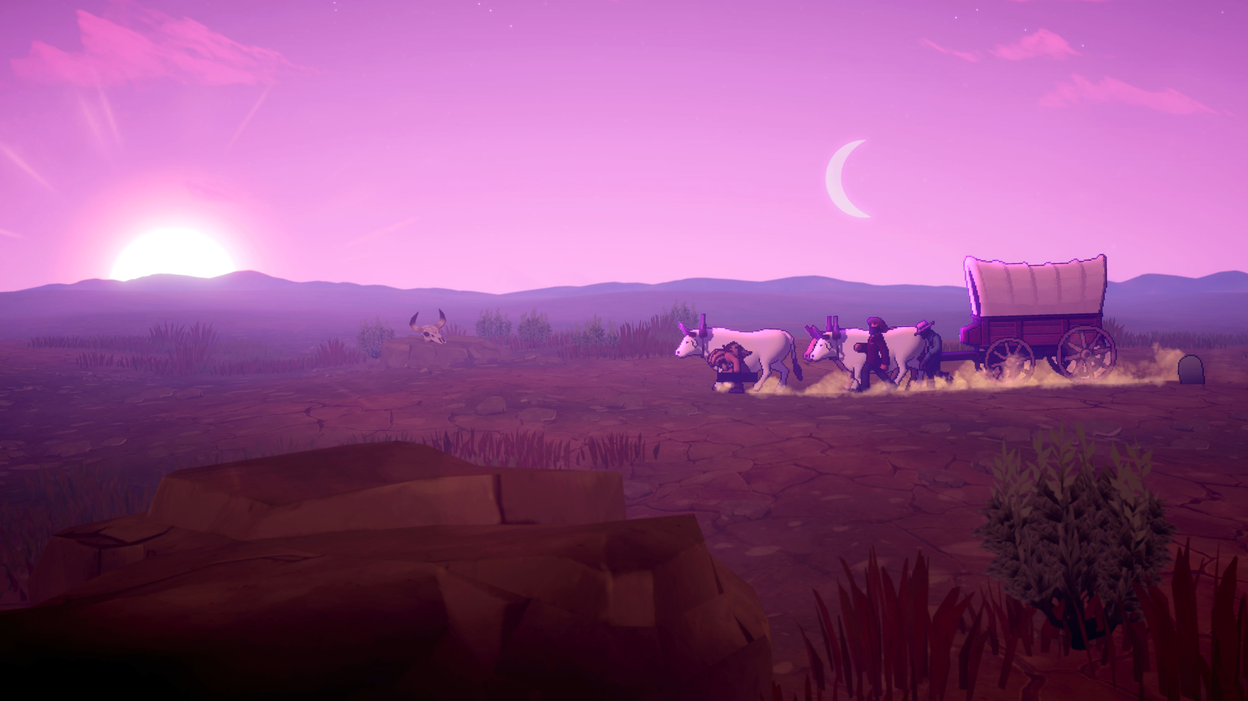
Actors
Unreal Engine v5.2
Courtesy of Gameloft Brisbane

Slide 26
Actors
Notes:
An Actor is any object that can be placed into a level.
Actors are a generic Class that support 3D transformations such as translation, rotation, and scale.
Actors can be created (spawned) and destroyed through gameplay code (C++ or Blueprints).
In C++, AActor is the base class of all Actors.

Slide 27
Tools & Features
Unreal Engine v 5.2
Image courtesy of Game Science

Slide 28
Lighting Tools
Notes:
UE5 has a very powerful and flexible light and shadow system.
Lumen is Unreal Engine 5's new fully dynamic global illumination and reflections system that is designed for next-generation consoles. Lumen is Unreal Engine 5's new fully dynamic global illumination and reflections system that is designed for next-generation consoles.
It renders diffuse interreflection with infinite bounces and indirect specular reflections in large, detailed environments at scales ranging from millimeters to kilometers.

Slide 29
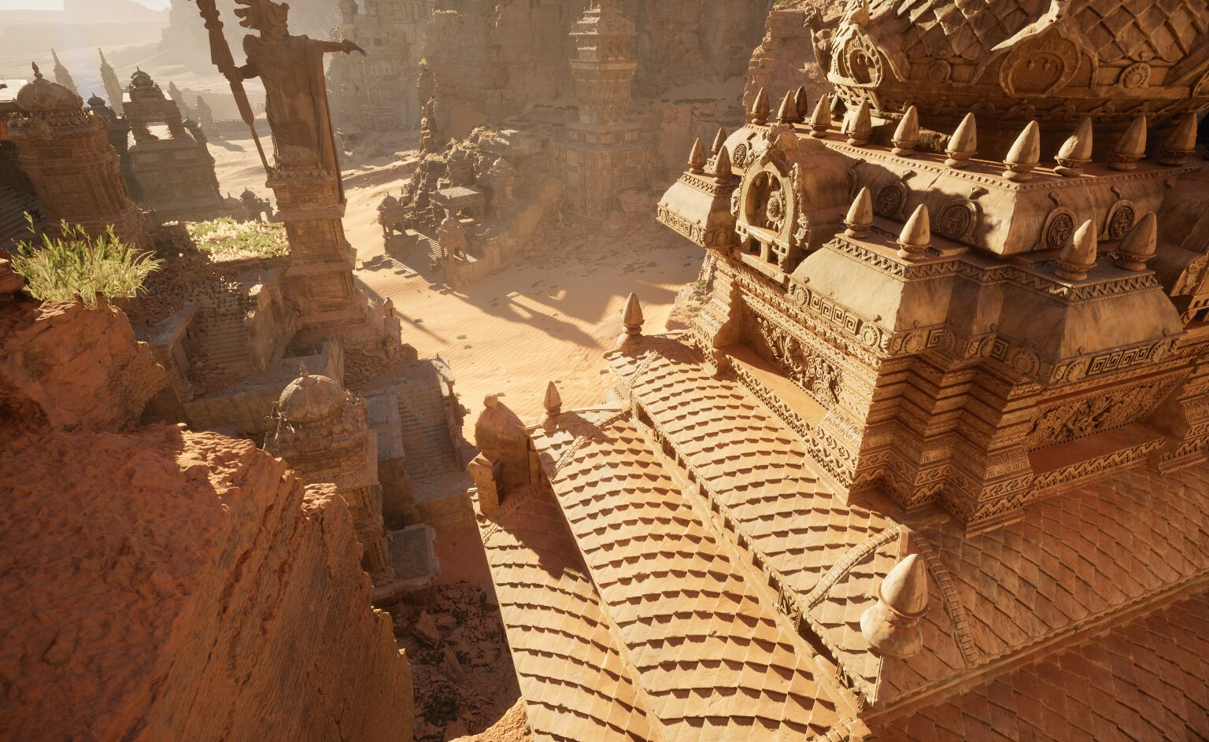
Shadowing Tools
Old
New
Notes:
UE5 has a very powerful and flexible light and shadow system.
Virtual Shadow Maps (VSMs) is the new shadow mapping method used to deliver consistent, high-resolution shadowing that works with film-quality assets and large, dynamically lit open worlds.
VSM are built to work seamlessly with Unreal Engine 5's Nanite Virtualized Geometry, Lumen Global Illumination and Reflections, and World Partition features.

Slide 30

Sky & Atmosphere Tools
Notes:
By placing a Sky Atmosphere actor in your scene, you can configure information about a simulated planet, including its ground radius in kilometers, physical parameters for its atmosphere, and art direction overrides.
This system works in conjunction with a Directional Light set as the Atmosphere Sun Light, as well as a Sky Light.
With all of these elements in place, the Sky Atmosphere system generates realistic atmosphere, volumetric clouds, and fog on a global scale. The environment lighting in this scene is completely dynamic thanks to the Sky Light's real time capture and convolution process.

Slide 31
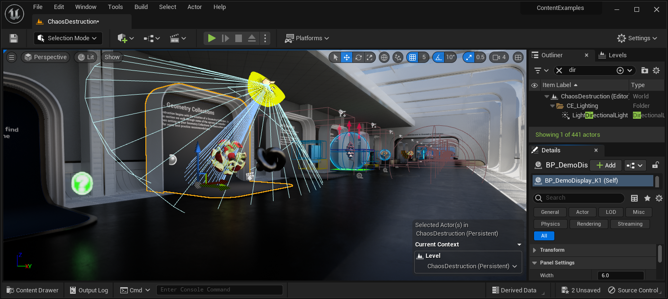
Level Editor
Notes:
The Level Editor is the primary Editor used to construct your gameplay levels.
Generally speaking it is where you define the play space for your game by adding different types of Actors and Geometry , Blueprints , Cascade Particle Systems or anything else that you want to add to your level.
By default, when you create or open a project it will open up to the Level Editor.

Slide 32
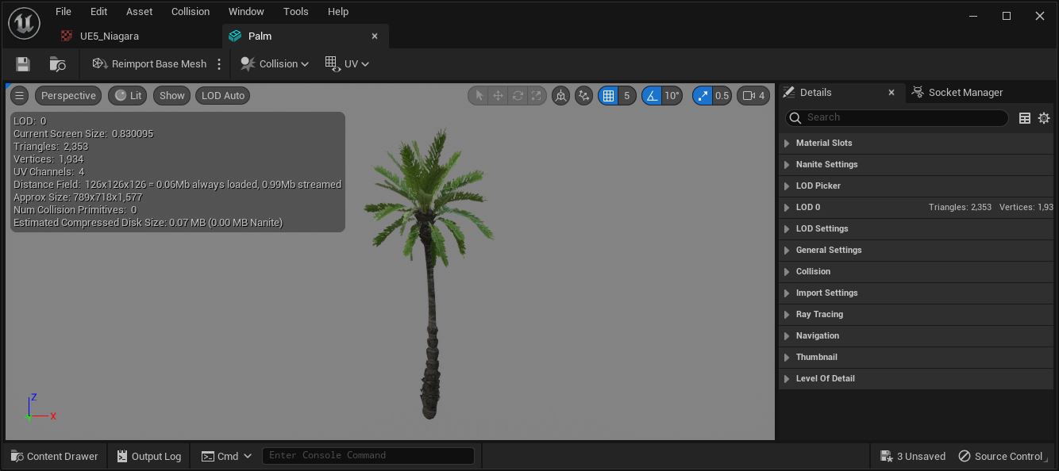
Static Mesh Editor
Notes:
The UE4 Static Mesh editor allows you to set and adjust the properties of Static Meshes that have been imported.
From the Static Mesh Editor you can do the following:
Apply or adjust Materials.
Enable or disable Nanite options.
Add or adjust LOD.
Add or adjust Collision.
Add or adjust sockets.
Enable or disable properties that affect how the Static Mesh is rendered.
Look at the mesh properties like Vertex Color, Pivot and Normals.

Slide 33
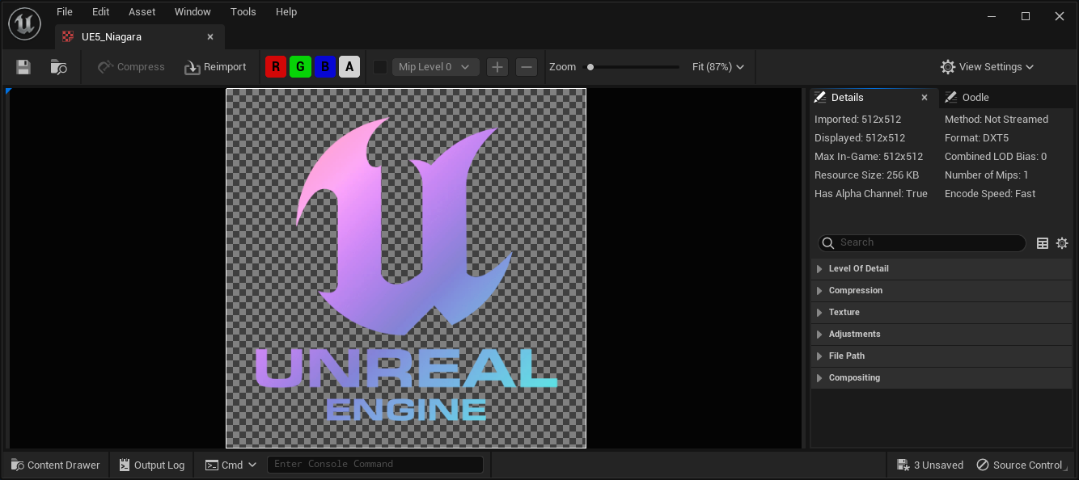
Texture Editor
Notes:
The Texture Editor allows you to adjust the textures that you have imported.
From the Texture Editor you can reduce the size of your texture or change the compression setting.
You can also adjust specific properties for any textures that are supposed to contain data like Normal maps or masks.

Slide 34
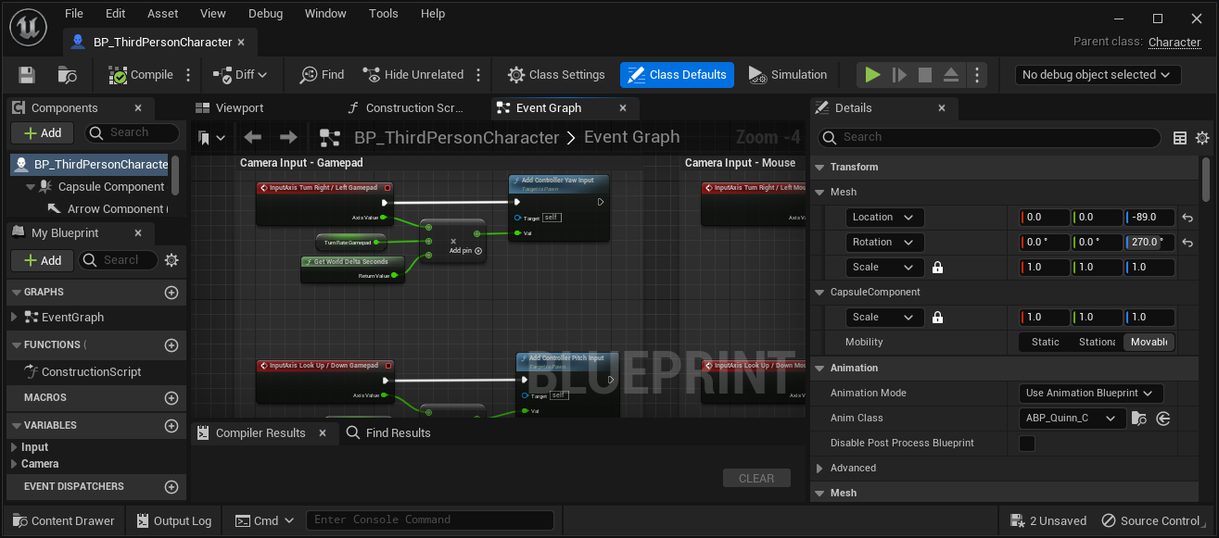
Blueprint Editor
Notes:
The Blueprint Editor is where you can work with and modify Blueprints.
Blueprints allow you to create code with out having to write and code in C++.
Blueprints are one of the way that you add interactivity to your project's.

Slide 35
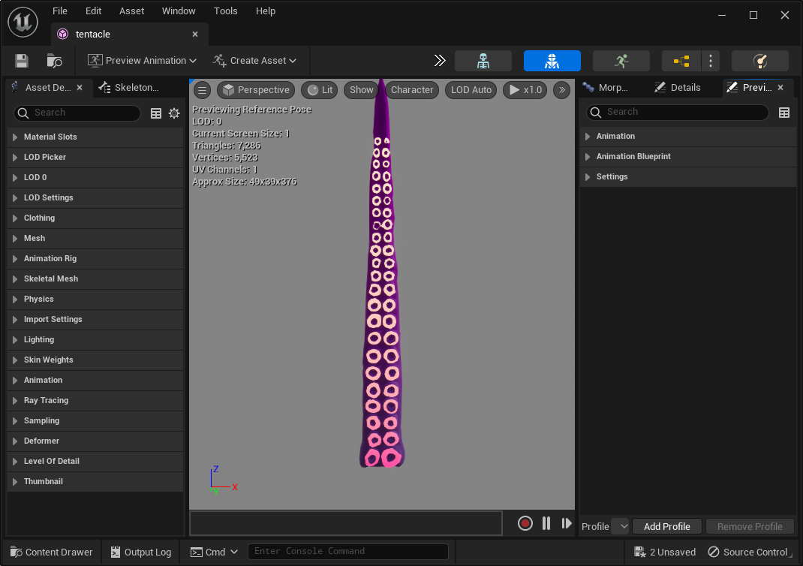
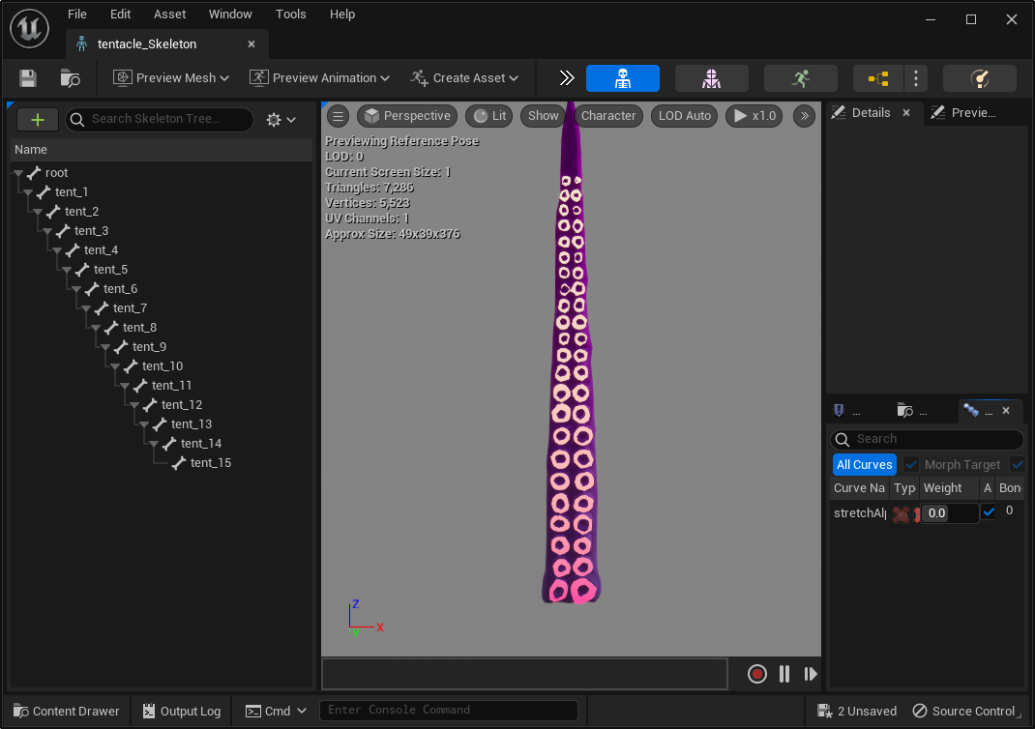
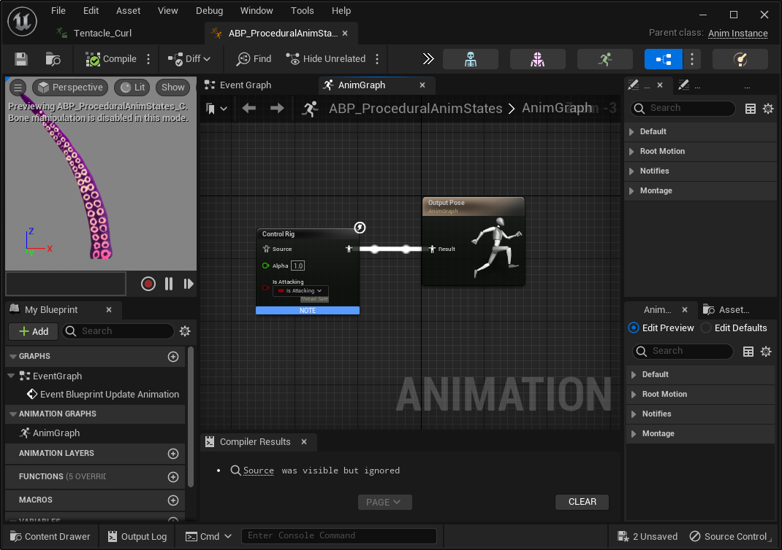
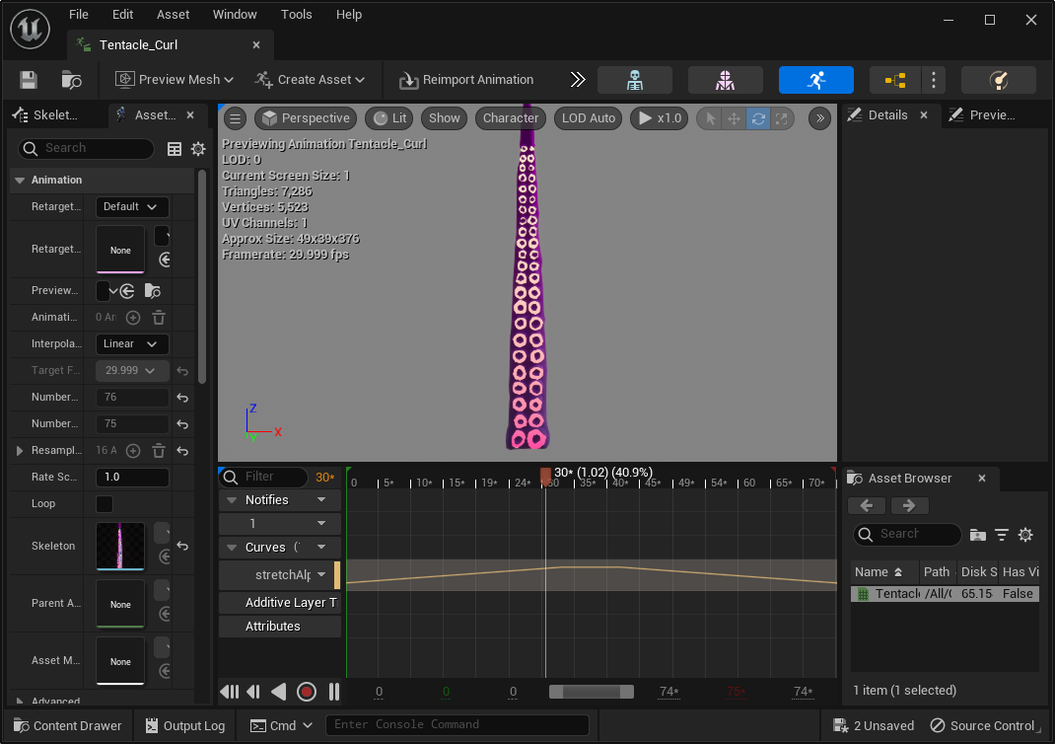
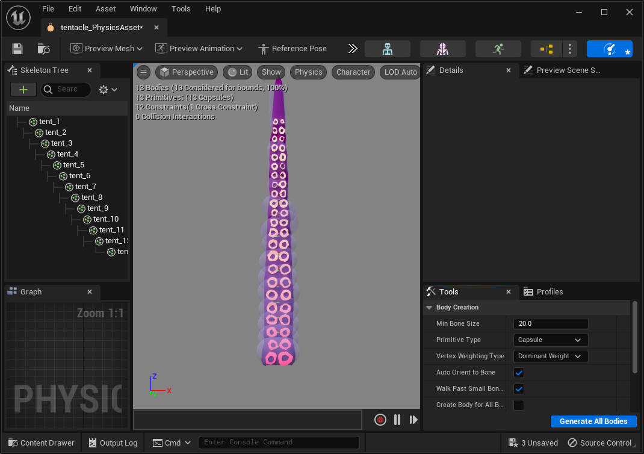
Animation Editor
Skeletal Mesh Editor
Skeleton Editor
Animation Blueprint Editor
Animation Editor
Physics Editor
Notes:
UE4 animation tools are made up of the following editors:
Skeleton Editor
The Skeleton Editor is a tool used for working with Skeleton Assets inside Unreal Engine 4.
It is in this editor where you can also set up your Animation Retargeting options and manage your retarget sources with the Retarget Manager.
Animation Editor
The Animation Editor provides easy access to the various animation-centric assets available for a Skeletal Mesh.
Physics Asset Editor
It is specifically designed to manipulate Physics Assets for Skeletal Meshes
Skeletal Mesh Editor
This editor allows you to make changes to the polygonal mesh by setting up Materials for the Skeletal Mesh, adding clothing elements, setting up LODs and testing out any Morph Targets applied to the mesh.

Slide 36
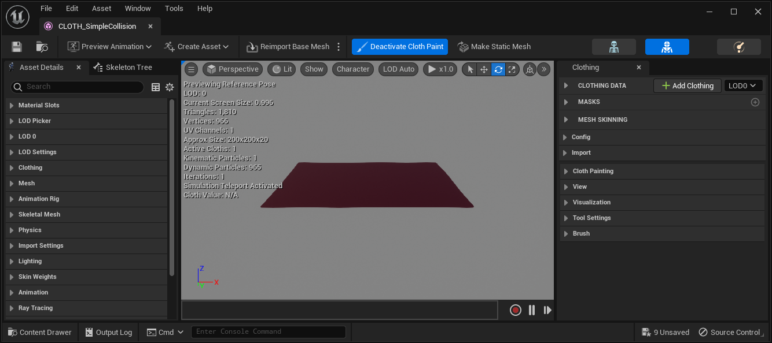
Clothing Editor
Notes:
Unreal Engine uses Chaos Cloth solver which is a low-level clothing solver responsible for the particle simulation that runs clothing.
This clothing solver allows integrations to be lightweight and very extensible because we now have direct access to the simulation data.
With the Clothing Tools available within the Editor, the workflow enables developers to work directly with Unreal Engine to author their content without the need for external dependencies.

Slide 37
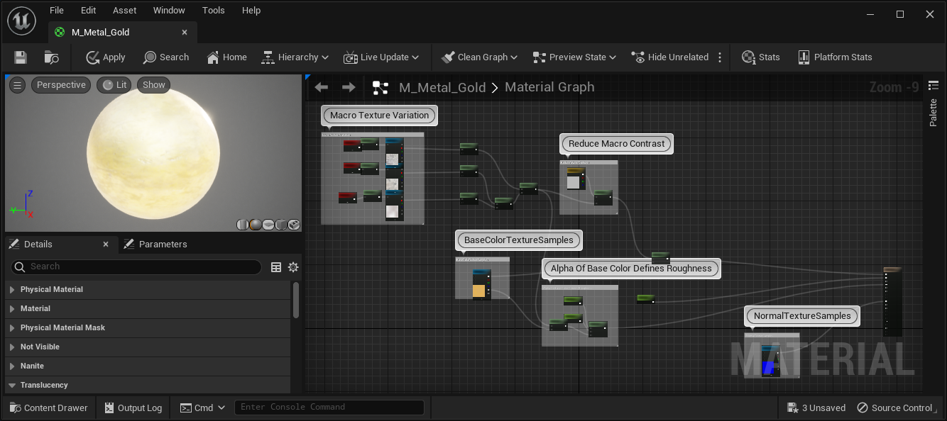
Material Editor
Notes:
UE4 comes with a very powerful Material Editor.
The Material Editor is a node-based graph interface that enables you to create shaders that can be applied to your geometry, such as Static and Skeletal Meshes.
You can also use Materials and Material Instance with tools like Blueprint or Niagara.

Slide 38
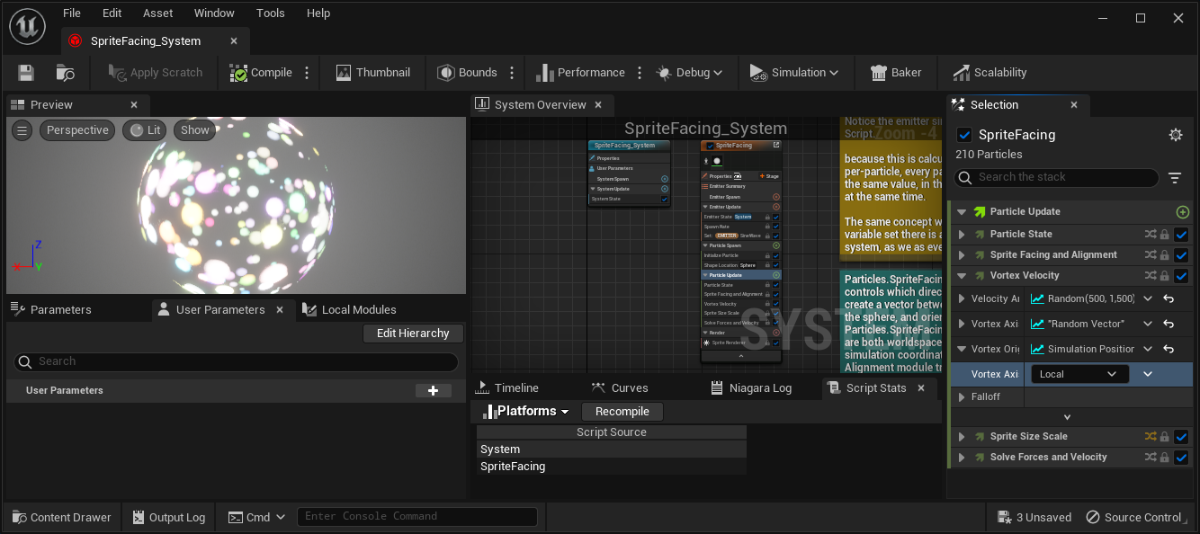
Niagara Editor
Notes:
Niagara is the tools that is used to create effects in UE5.
Niagara gives artist the ability to change how any part of the VFX pipeline works all without the need of an engineer to help out.
Niagara makes it even easier to interface with VFX data using Blueprints.

Slide 39
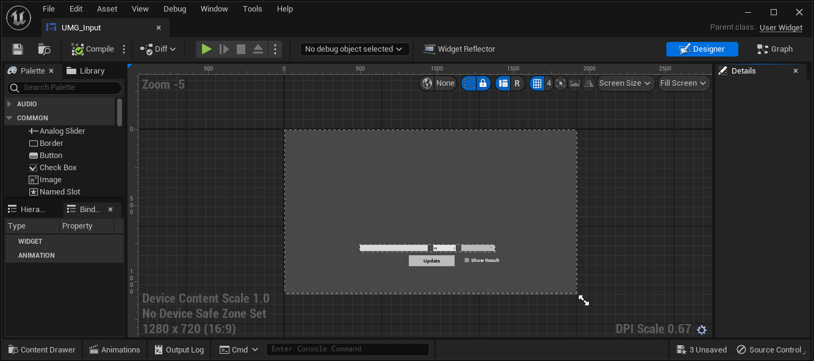
Unreal Motion Graphs Editor
Notes:
Unreal Motion Graphs or UMG is the tool used to make user interfaces in UE5.
UMG provides all of the base functionality that you would need to make a UI.
In UMG you can find, buttons, radio buttons and many more common UI interface options.

Slide 40
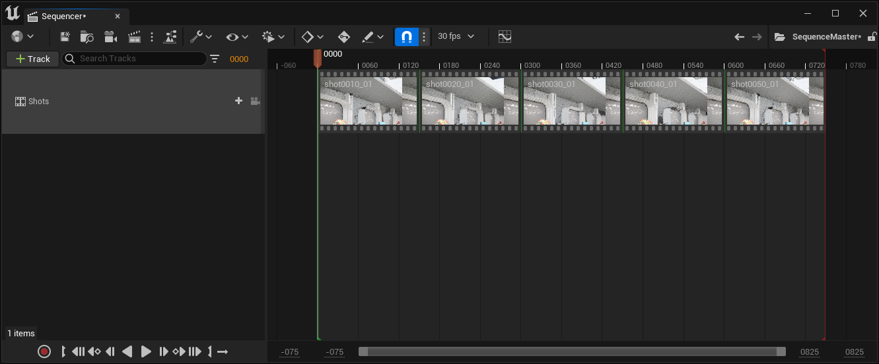
Sequencer Editor
Notes:
Sequencer is the tool that you use for cinematic and linear media.
You can use this tool to power your in game cut scenes or feature length film.
You can even use sequencer in combination with live action game play.

Slide 41
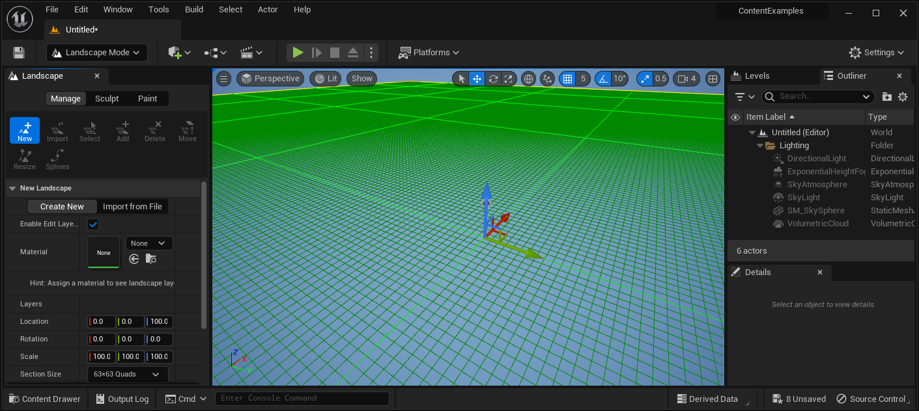
Landscape Mode
Notes:
The landscape tools in UE5 allow you to setup massive open world landscapes.
With the Landscape tool you can sculpt the look of the landscape using the built in tools or import from a heightmap.
You can also use the Landscape tools to paint different materials on your landscape.

Slide 42
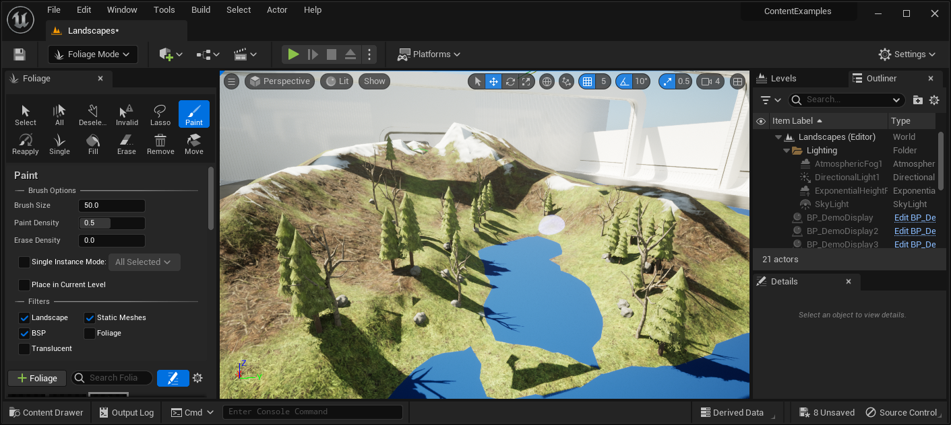
Foliage Mode
Notes:
The foliage tools in UE5 allow you to quickly add static meshes to your scenes with out a lot of hassle or setup.
The foliage tool allows artist to add things like random scale or restrict the location something can be placed.
The foliage tools give artist complete control over the location foliage is placed, artis can fill a valley full of grass or just edit a single blade that should not be stick out.

Slide 43
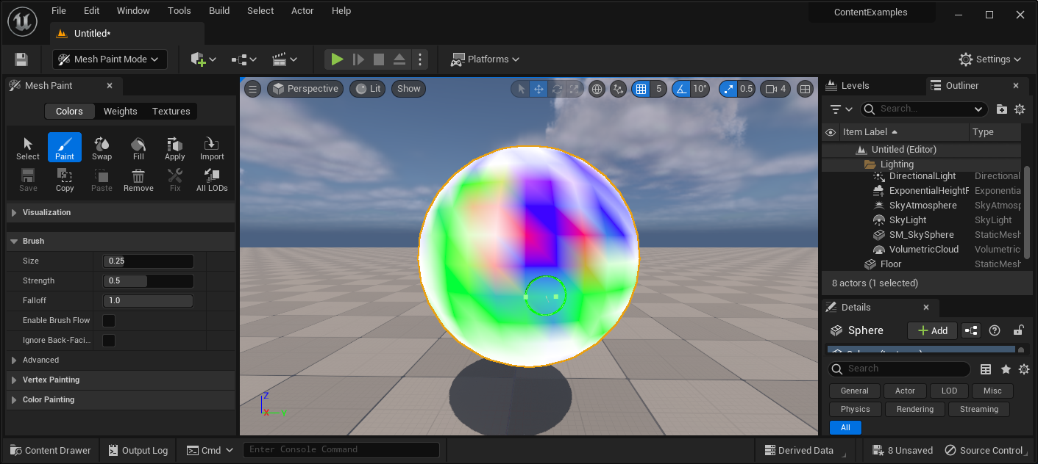
Mesh Paint Mode
Notes:
Mesh paint allows you to paint on selected meshes in the viewport.
You can use this tool to adjust vertex colors so that two materials can be blended together.
You can also paint directly on an objects base texture using the textures option.

Slide 44
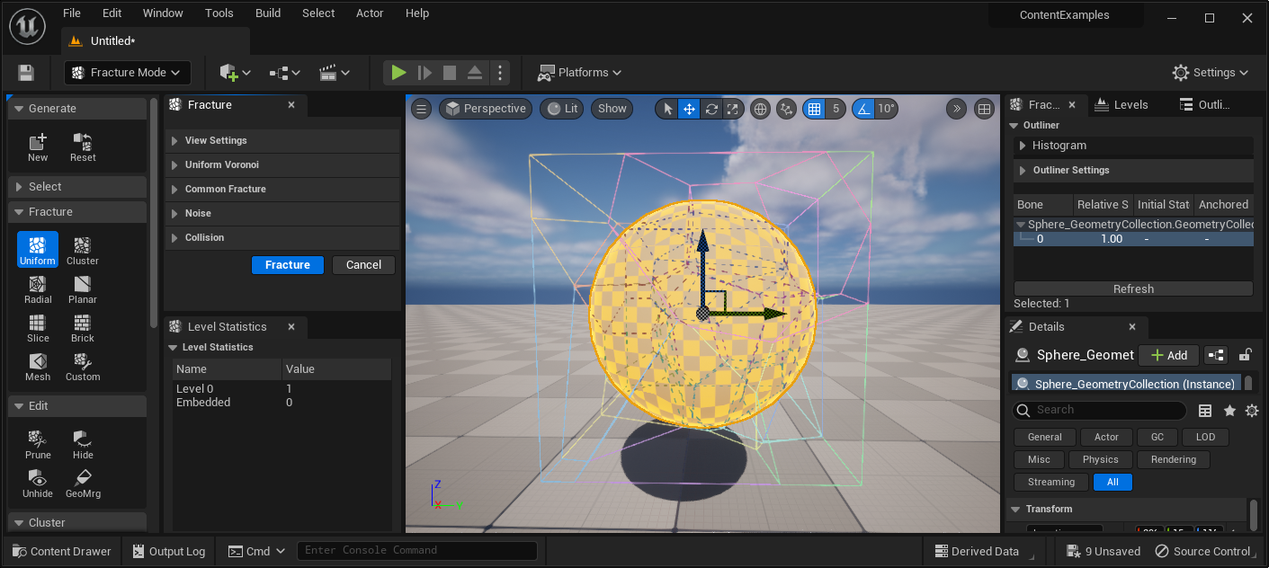
Fracture Mode
Notes:
Part of the Chaos Destruction tools, the fracture tools allows you to create cinematic quality fractures that run with real time performance.
The fracture editor allows you to create fractured versions of static meshes that can be used to help increase the realism of destruction, both nature and man made.
The fracture editor gives your full control over how the fracture object should react and look.
With the fracture editor you can also specify multiple levels of destruction allowing you to define how something should look at the start and all the way until it has been completely destroyed.

Slide 45
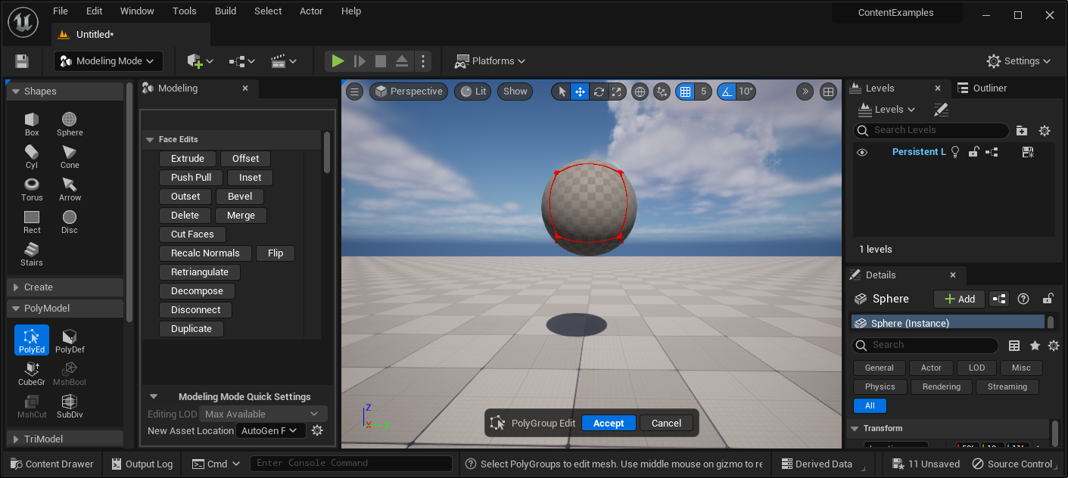
Modeling Mode
Notes:
Modeling Mode contains a variety of tools for creating both simple and complex 3D assets for all your visualization projects.
These tools are designed to streamline the asset creation process and are compatible with meshes created using traditional workflows, as well as more complex meshes that are generated by photogrammetry.
The Modeling editor mode provides a toolset for creating and sculpting static meshes directly in Unreal Engine.
You can use it to create new meshes, rapidly prototype level geometry, and edit existing models to add variety to your world.

Slide 46
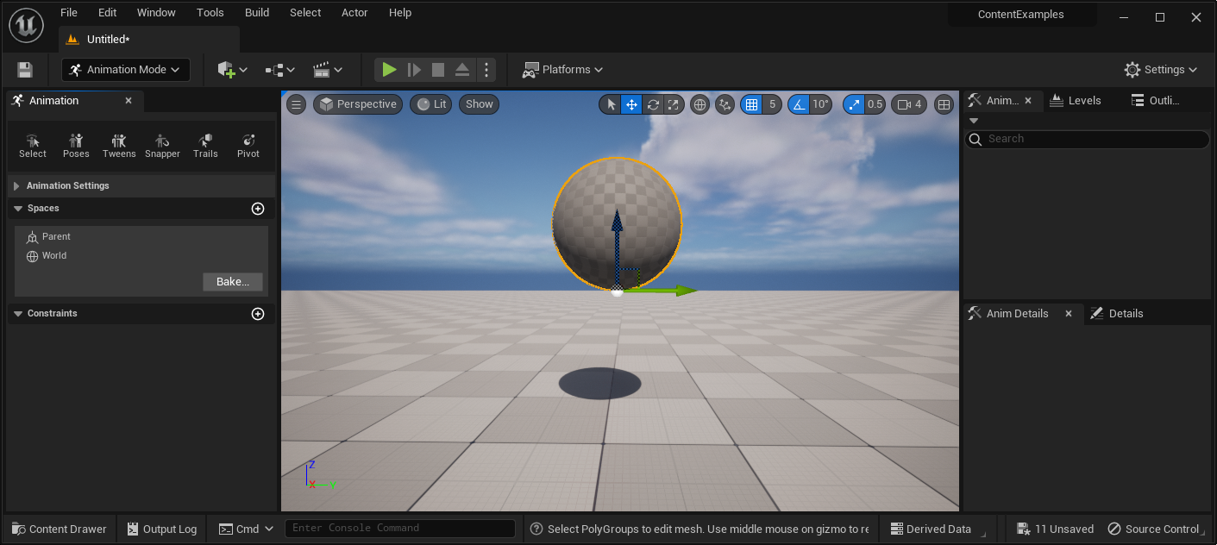
Animation Mode
Notes:
Animation Mode is a Mode in Unreal Engine that exposes new tools, panels, and editor behaviors that assist your animation workflows.
Using this Mode when animating with Control Rig offers a more animation-focused editor experience, with tabs to aid in selecting Controls, transform displays, and launching tools.
Animation Mode is mainly dependent on using Control Rig within Sequencer, therefore a basic knowledge of Sequencer is required.

Slide 47
Your First Project in Unreal Engine for Game
Unreal Engine v5.2
Background Concepts and Formatting Updates

Slide 48
Levels
Unreal Engine v5.2
Image courtesy of Game Science

Slide 49
LEVELS – Level Concepts
Project
Levels
Sub - Levels
Actors
Notes:
Project Structure: how things are organized.
An Unreal Engine project is not made of a single file but rather a collection of source-code files, content asset files (as you create and/or import them), plugins, configuration files, and other support files.
A Level is a container for every object you see and interact with. It comprises a collection of assets that work together to bring your vision to life. It can range from massive worlds to small rooms with only a few actors.
A Sub-Level is technically a level in its own right but is mainly used for the purposes of level-streaming, where you can load and unload parts of your world to increase performance.
The nature of a sub-level is such that it is often used in collaborative environments.
A given level can then reference a sub-level in your project for various reasons, including level streaming.
Actors can be placed in the world and transformed through Move, Rotate, and Scale.
They can be rendered and have materials applied, collision properties, and scripted logic, and they can also be animated.
There are different classes of actors, such as the StaticMeshActor, which is most common, but also for lights, sounds, particle systems, and cameras.

Slide 50
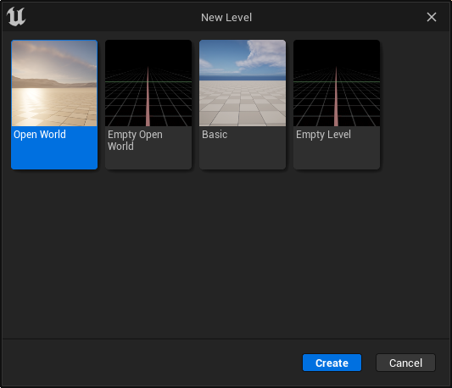
LEVELS – Level Creation
Notes:
To make a new level go to File -> New Level.
This will evoke the new level dialogue box.
From the New Level creation you can do the following:
Create a new Open World style level that has landscape and lighting that is preset up to work with massive open world projects.
Create an empty Open World style level that has the bare minimum setup needed to work with open worlds.
Create a basic map that has a few actors setup to work as a level.
Create a level that has nothing inside of it.
For now select the Basic option and then press Create/

Slide 51
Building Levels
Unreal Engine v5.2
Image courtesy of Game Science

Slide 52
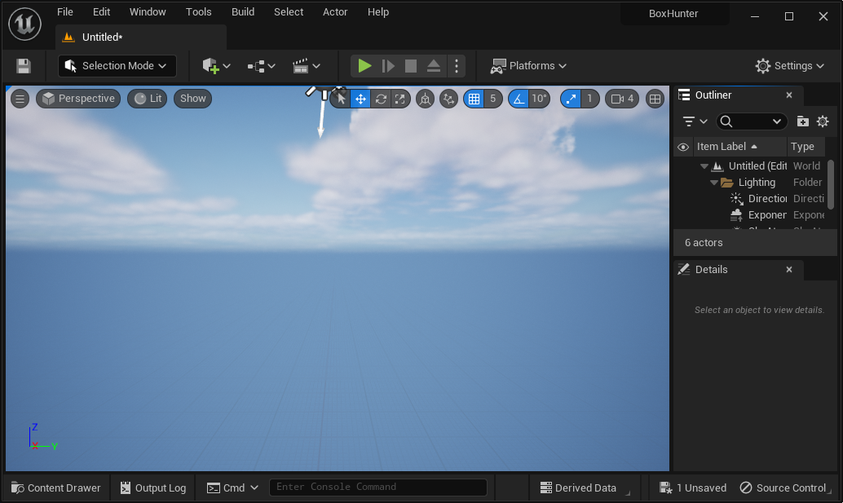
BUILDING LEVELS – First Steps
Notes:
Create a new level and select the Basic option.
Then press the create button.
Once the level is created, delete the floor static mesh.
Save the level in the level folder with a name of Level_02.

Slide 53
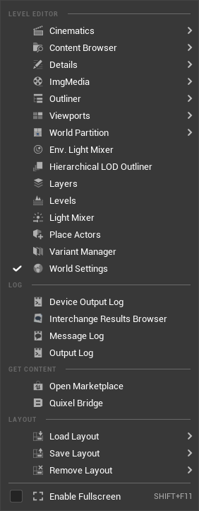
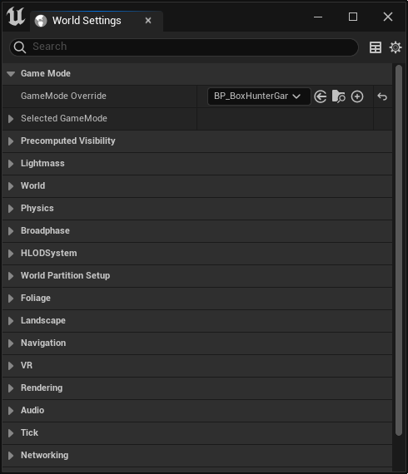
BUILDING LEVELS – World Settings
Notes:
Locate the world settings menu.
Generally this docked in a tab next to the details panel.
If you don’t have it go to Window -> World Settings
The World Settings menu defines the base settings a level should have.
For example when this level is loaded, how should it be played by the end user and what should they look like.
For this level we need to make sure that the game mode for our project is loaded.
To do this locate the Game Mode override in the world settings.
Click on the drop down and then locate the BP_BoxHunterGameMode.
There is a lot in here so take some time to look the options over.
Once you have done this make sure to save the map.

Slide 54
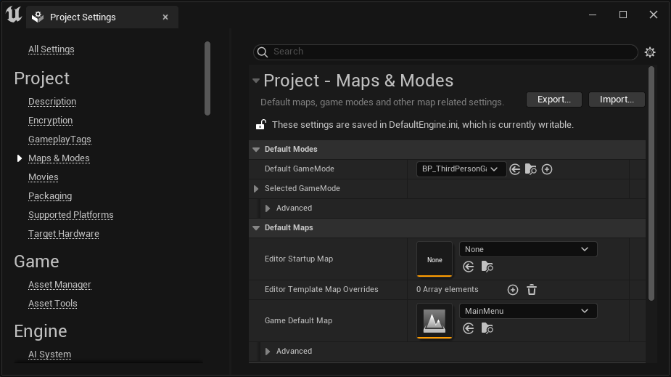
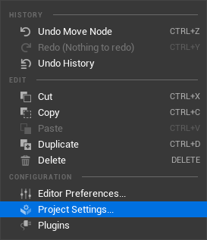
BUILDING LEVELS – Level Setup
Notes:
You can set the level that should load both when the editor starts and when the game starts.
You will the option to do this under Project Setting -> Maps & Modes -> Default Maps
For this make sure the Editor and Game are set to the level you created in the previous step, Level_02.
You can use one map or multiple maps depending on the needs of your project:
This project uses two levels, a main menu and a game level.
Levels are flexible enough to meet the needs of any project created in UE5.
You can have one level or multiple levels, it is up to you and the needs of your project.

Slide 55
BUILDING LEVELS – Finding Actors
Notes:
There are a number of different ways to find Actors.
Quickly Add To Project Menu:
From this menu you can find a wide variety of default UE5 actors to place.
From lights to cameras and even basic static meshes can be placed into your levels from this menu.
You can search for items by name or go through the menus.
Content Browser:
From this menu you will find all of the custom assets you have imported or created in UE5.
You can use the search menu or the very power filters to filter by specific content types.
Make sure you are on the Content folder to get the best out of the filters.

Slide 56
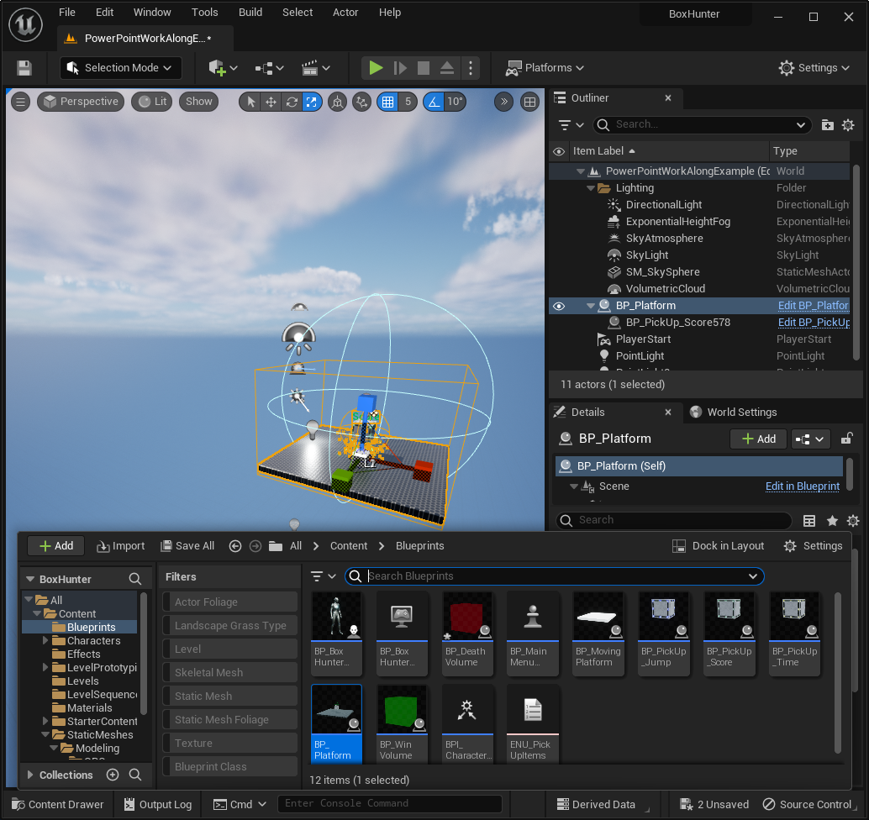
BUILDING LEVELS – Actor Placement
Notes:
Placing actors can be done two ways:
Quickly Place menu
Search for the item you wish to place.
Once located, click on it to add it to the level.
It will be added somewhere close to the camera.
Content Browser
Search or use the filters to find the assets you want to add.
Once located, drag from the CB into the viewport.

Slide 57
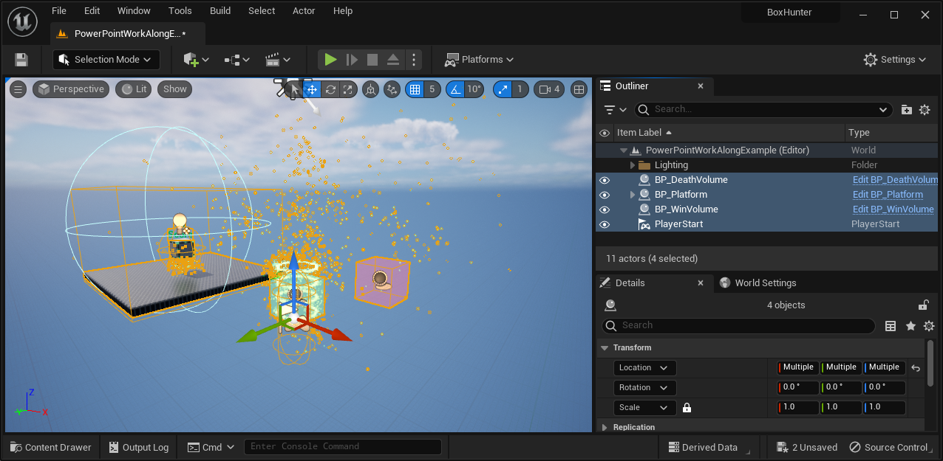
BUILDING LEVELS – Actor Manipulation
Notes:
First we are going to 0 out the pivot of the following actors to make sure everything is close to the center of the world when we start.
Player Start
BP_Platform
BP_DeathVolume
BP_WinVolume
To zero out the transform simply press the small return arrow next to the X, Y, Z in the transform/
This process of ”zeroing out the transform” is a common practice, as it helps to make sure the items we need are close together.
Select the death volume and expand it so that it covers a wide area under the player start.
When the user falls into this volume, the round will re-set.

Slide 58
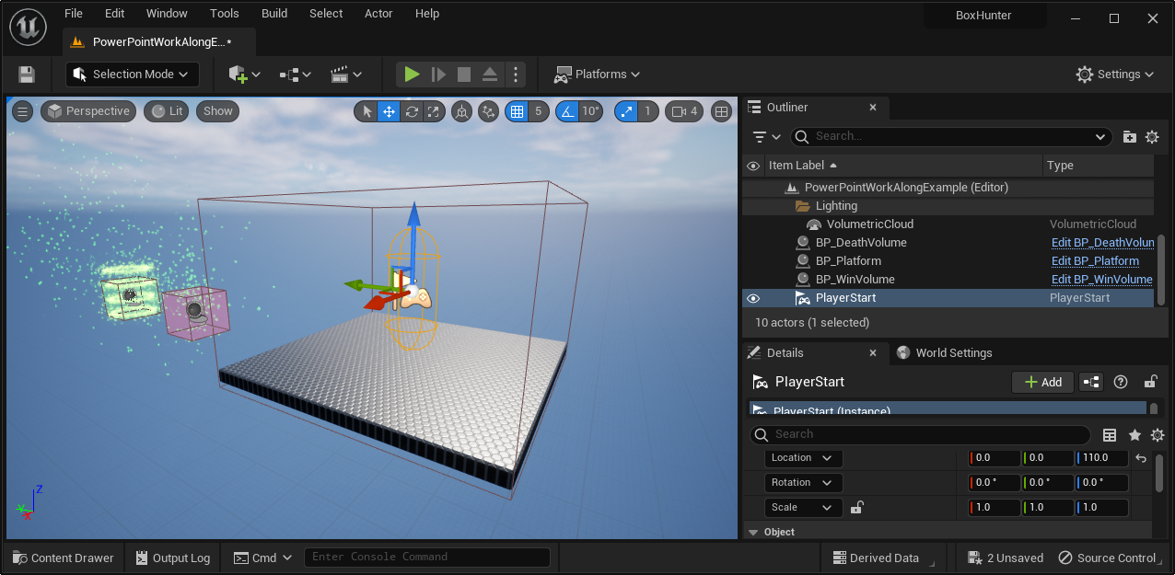
BUILDING LEVELS – Working With Actors
Notes:
Select the Death and Win Volumes and move them out of the way so that we can locate the following two Actors:
BP_Platform
Player Start
Set the z location value of Player Start to 110.
This should moved it above the platform.
Now press the Play button to make sure you spawn in on the platform.
ALT – P does to too!
You can duplicate actors by holding shift and dragging the transform gizmo in the X, Y, or Z direction

Slide 59
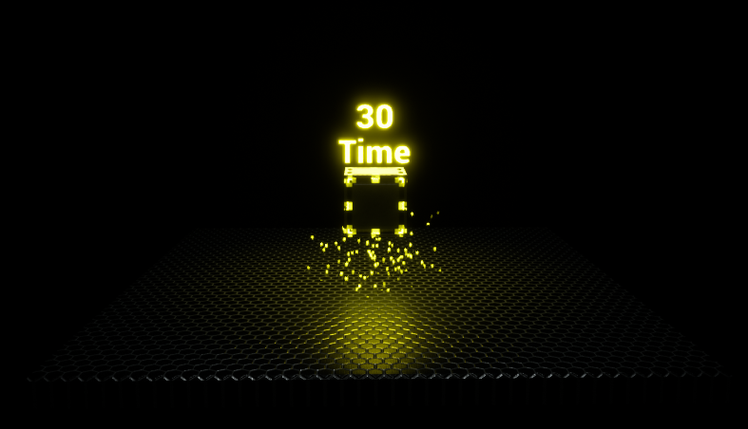
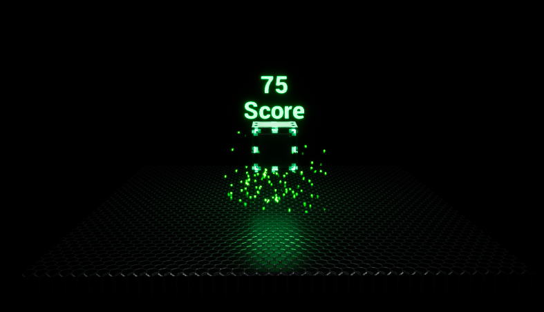
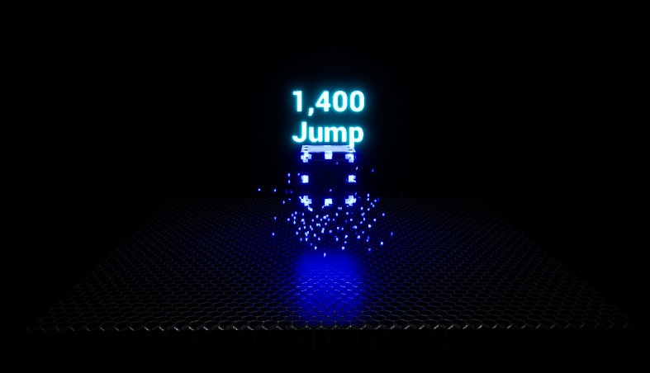
BUILDING LEVELS – Working With Properties
Notes:
Each actor or uobject you select will have properties you can interact with.
Properties can be as simple as what color is this light or more complex, being derived from data that is only created and used at runtime.
Select the BP_Platform actor and look for the Default section.
Locate the Pick up Type and change it from None to Jump, Score, Or Time.
Doing this will change the pick up to do something different to the player.
Once you have selected a new type, run the project to see the effect the pickup has on the user.
Once you have finished testing that, check out the other parameters that do the following.
Rotate – Enabled the entire platform to rotate when jumped on.
Duration – Time that is should take the platform to move from point A to point B.
Falling – Enable the platform to use physics to fall once the player has jumped on it.
Enable Platform Movement - This will enable the platform to move from point A to point B.
L1 & L2 – These are the points that the platform will move between.
You can modify these by click on the blue Dimond shape in the viewport editor and then moving that point.
Score Amount – This is the amount of points this will award if the use get’s this object.
Jump Power – This will increase the heigh the user can jump to.
Time Amount – This will increase the amount of time that is left.

Slide 60
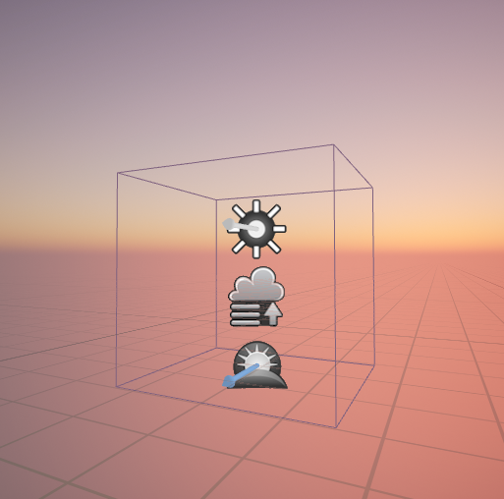
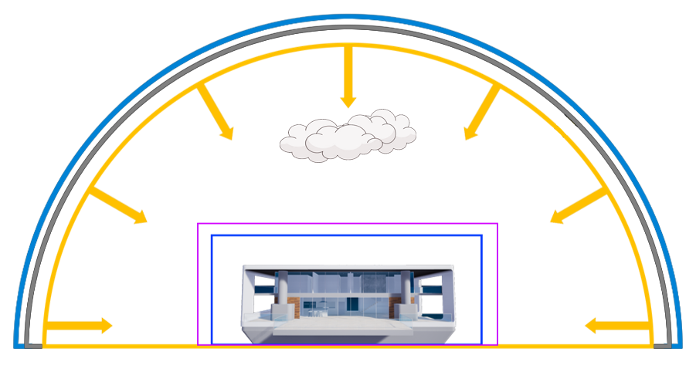
BUILDING LEVELS – Working With Lights
SKYDOME
SKY LIGHT
ATMOSPHERE
DIRECTIONAL (SUN)
VOLUMETRIC CLOUDS
POST PROCESSING VOLUME
LIGHTMASS IMPORTANCE VOLUME
Notes:
Required:
A directional light source to simulate the sun.
Make sure to set it to Movable.
A Sky Atmosphere
The defaults, for now, will be okay.
An Exponential Heigh Fog
The defaults, for now, will be okay.
A Post Processing Volume
Set the Unbound so it will be applied to the entire scene.
Optional:
A Sky Light to contribute to the Global Illumination
Volumetric Clouds
You can use CTRL + L to adjust the lighting.

Slide 61
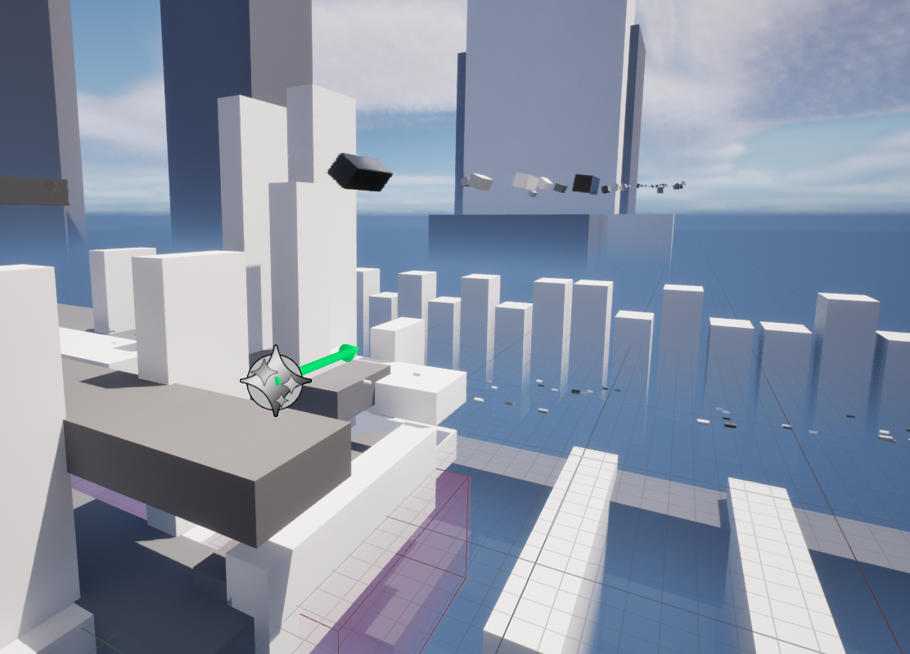
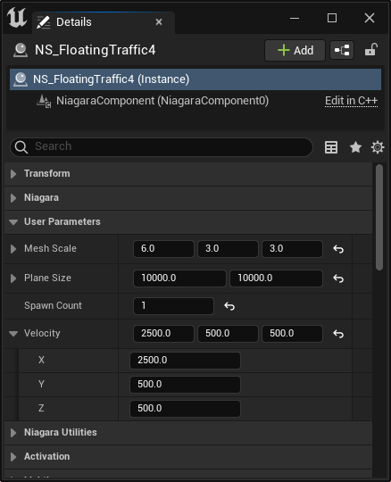
BUILDING LEVELS – Adding VFX
Notes:
The “flying cars” are just a Niaga VFX emitters
You can adjust things like the size of “cars” as well as how many will be spawned, how fast they will travel and how densely packed they will be.
The emitter has been set to local space so that the “cars” will travel forward.
Rotating the emitter will make the cars direction rotate.
Duplicate the emitter or adjust the properties of an existing to see how they work

Slide 62
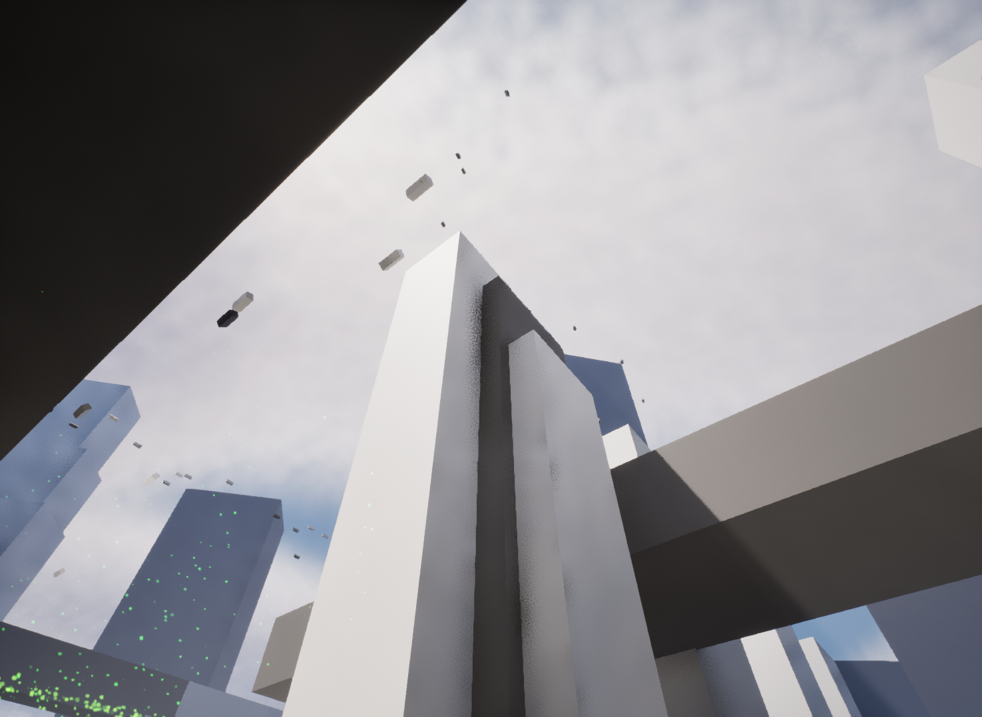
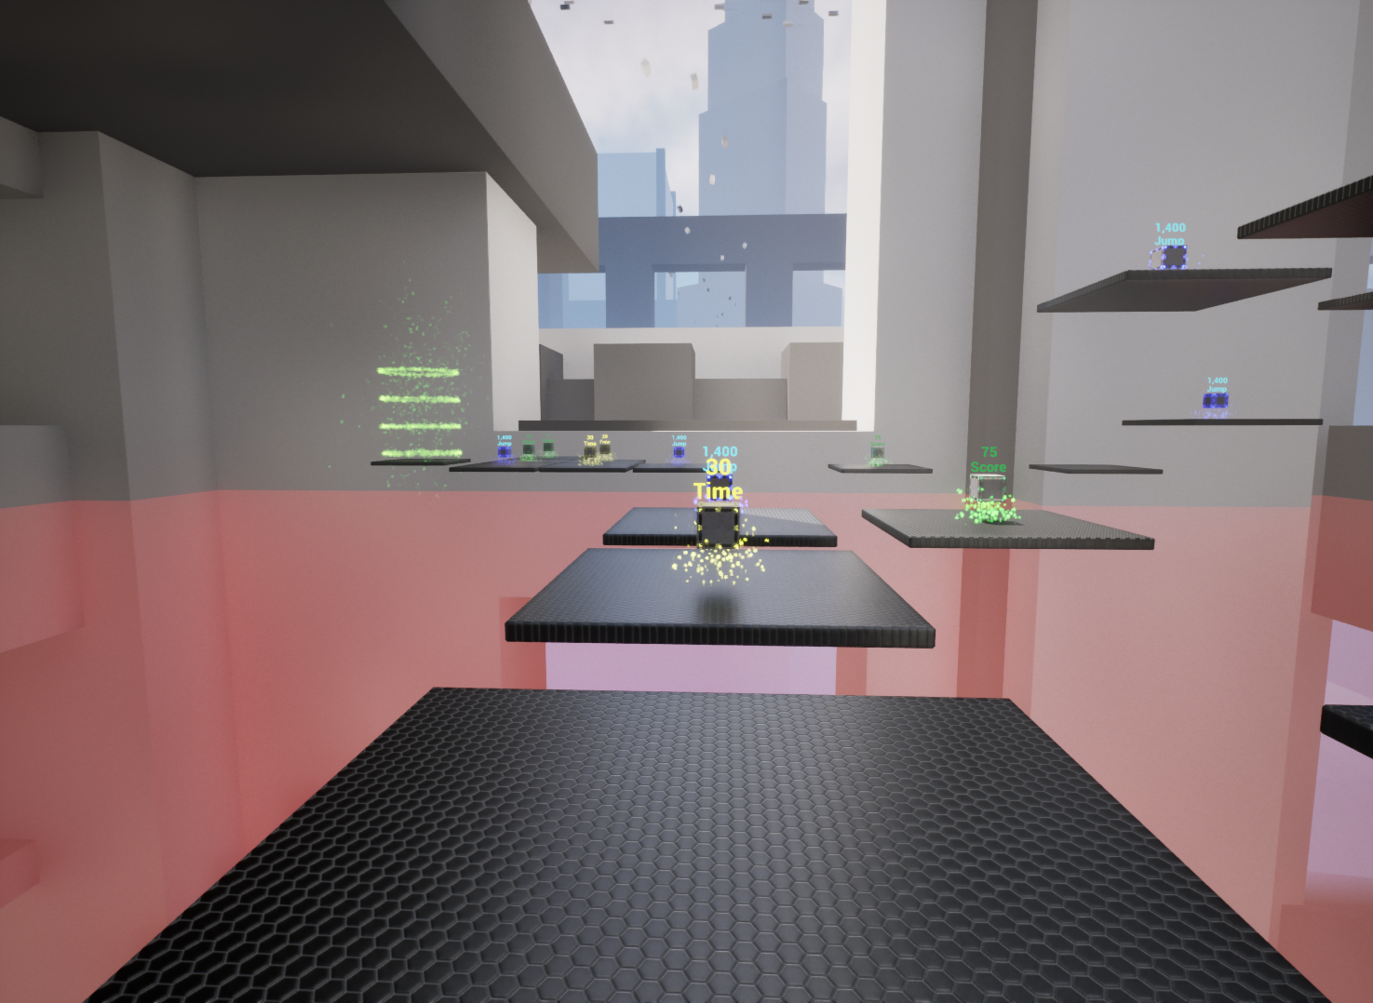
BUILDING LEVELS – Background Props
Notes:
Now with the basics setup you can add more platforms and pick ups for the user to get.
Make sure to safe your work often.
You can use the shift and drag technique to quickly duplicate existing objects in the world.
All of the buildings you see are the same static mesh cube, just scaled and with different materials applied to it.

Slide 63
Publishing
Unreal Engine v5.2
Image courtesy of Game Science

Slide 64

Publishing – For Windows
Notes:
Publishing this project to an .exe can be done in a few steps.
First you need to make sure you have UE5 Turnkey setup so that you have the required windows SDK.
You can read more about how to do that here:
https://docs.unrealengine.com/5.0/en-US/using-the-platforms-dropdown-in-unreal-editor/
Go to Publish -> Windows -> Package Project.
You will then be prompted to select a location for the cooked project files to be placed when done.
For this example I used a new folder on the desktop.
The image on the left shows the popup that will be displayed while the packaging process takes place.

Slide 65

Publishing – For Windows
Notes:
Once the cooking process has finished, you will now have an .exe in the folder you specified.
The first time that you cook for windows it will be extremally slow.
Additional cooks will be completed much faster.
Double click on the exe to launch the game .exe like any other program.
If the project becomes stuck or non-responsive you can “kill it” by pressing ALT + F4.

